Slide 1
Activities in Q
Dimple Keen and Beth Banfield, with Oxford AHSN
May 2018

Slide 2
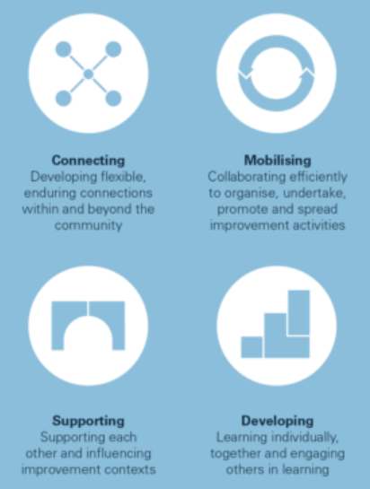
Q’s theory of change
Variety of offers to suit many needs

Slide 3
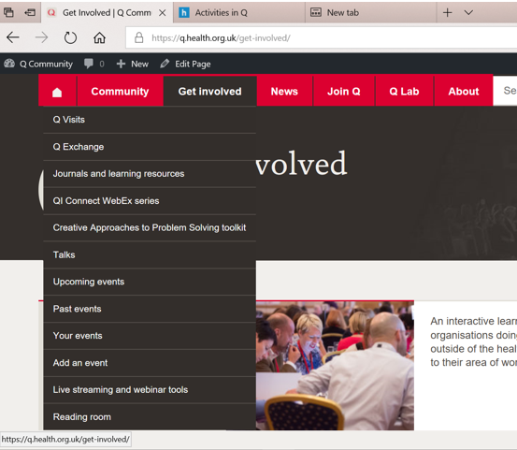
https://q.health.org.uk/get-involved/
Also groups and member directory under Community

Slide 4
 | Connect | Develop | Support | Mobilise
5 minutes | Twitter | Download CAPS Read a blog | Comment on a blog
30 minutes | RCTs | QI Connect webex IHI Open School BMJ Q&S journal | Write a blog | Lead a Group Arrange Group meetings
Longer | UK-wide Community event | Q Visit | Publish article in BMJ Open Quality Run a talk | Q Exchange Q Lab
Share your knowledge across the Community

Slide 5
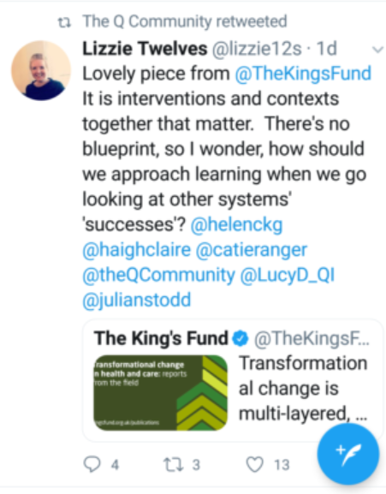
What can you do if you only have 5 minutes?
Twitter – @theQCommunity
7000+ followers
Benefits: quick, easy access to resources, easy help
Twitter ‘cheat sheet’
Qmunicate monthly newsletter
Benefits: quick summary, signposting to various resources and blogs, events and latest news

Slide 6
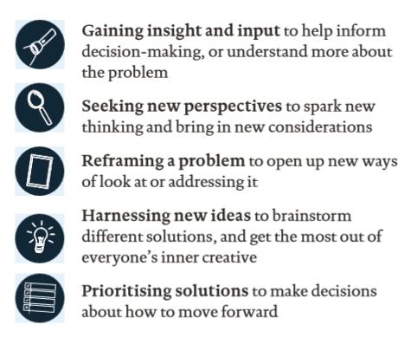
What can you do if you only have 5 minutes?
Download the CAPS toolkit
https://q.health.org.uk/get-involved/creative-approaches-problem-solving-caps/
Benefits: many techniques, innovative
Read a blog / Spark page about a recent visit
e.g. Liberating Structures sharing learning: https://spark.adobe.com/page/8osFmu4j2mpIz/
Benefits: Gain some knowledge from events you can’t attend, see what else is happening in improvement
Comment on a blog

Slide 7
What can you do if you only have 30 minutes?
Write a blog
https://q.health.org.uk/news/your-news-stories/?biro-post=0 (add news story)
Benefits: share your learning, generate ideas, inspire others
Start or join a group https://q.health.org.uk/community/groups/
Contribute to conversations on the group pages, join or lead a teleconference
Benefits: share good practice, problems and ideas with others interested in the same topic as you
Listen to a QI connect webinar (from Healthcare Improvement Scotland)
https://q.health.org.uk/get-involved/qi-connect-webex-series/
Benefits: excellent speakers, inspiring

Slide 8
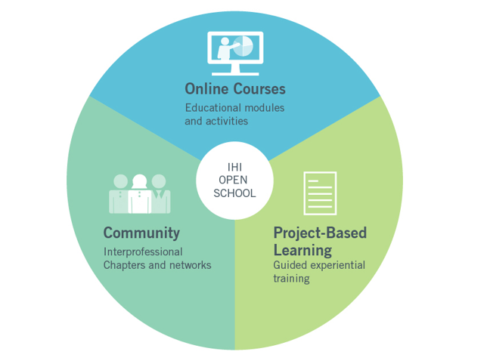
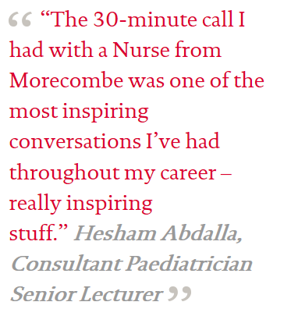
What can you do if you only have 30 minutes?
IHI open school
Benefits: develop your knowledge, learn more about specific improvement topics
https://q.health.org.uk/get-involved/journals-and-learning-resources/
Read the BMJ Quality and Safety journal
Benefits: further increase knowledge in current topics, keep abreast of new articles
RCTs
https://q.health.org.uk/community/rcts/
Benefits: connect with others in the Community, share ideas, gain inspiration

Slide 9
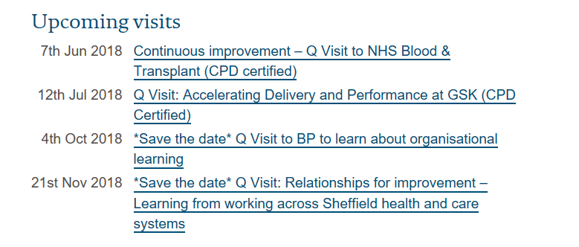
What can you do if you have a bit more time?
Attend a Q visit
Benefits: gain new knowledge, learn new approaches, generate ideas
https://q.health.org.uk/get-involved/q-visits/
Write up your Quality Improvement report through BMJ Open Quality
Benefits: develop skills in writing up reports, share your improvement experience with others (not just Q members), contribute to wider health debates
https://q.health.org.uk/get-involved/journals-and-learning-resources/
“Collaborative approach to reducing cardiac arrests in an acute medical unit”
http://bmjopenquality.bmj.com/content/bmjqir/6/2/e000026.full.pdf
Offer to run a Talk https://q.health.org.uk/get-involved/talks/
Benefits: share knowledge and expertise with others, help build capacity and capability

Slide 10
What can you do if you have a bit more time?
Join the Q lab https://q.health.org.uk/q-improvement-lab/
Benefits: deep insight and knowledge in a specific area, test solutions, tackle complex problems
Get involved with the Q Exchange! – **deadline 21 May**
https://q.health.org.uk/get-involved/q-exchange/
Benefits: access to funding of £30k, develop your improvement project, personal development (pitching, providing feedback)
Attend an event/workshop https://q.health.org.uk/event/q-uk-wide-community-event/
UK-wide Q Community event in Sept – **final 50 tickets**
Local events too
https://q.health.org.uk/get-involved/events/
Benefits: make new connections, develop skills, collaborate with others

Slide 11
Want to contribute more to Q?
Annual and adhoc RAND surveys
Contribute to the evaluation of Q
How can we share the impact Q is having on you and your improvement work?
Opportunities to be involved in designing aspects of Q
the UK-wide Q community event
Design of Q exchange
Theory of Change webinar – 7 June
See Natalie’s blog for more info https://q.health.org.uk/news-story/refreshing-qs-theory-of-change-get-involved/

Slide 12
What can we do for you?
Anything you’d like to see in Q or any further help needed?

Slide 13
Q@health.org.uk
Dimple.Keen@health.org.uk

