Slide 1
Trello – The e-Platform for Education & Training in Emergency Medicine
Dr. Justine Loh
RCP Chief Registrar in Emergency Medicine
Royal Berkshire NHS Foundation Trust
Oxford

Slide 2
What is Trello?

Slide 3
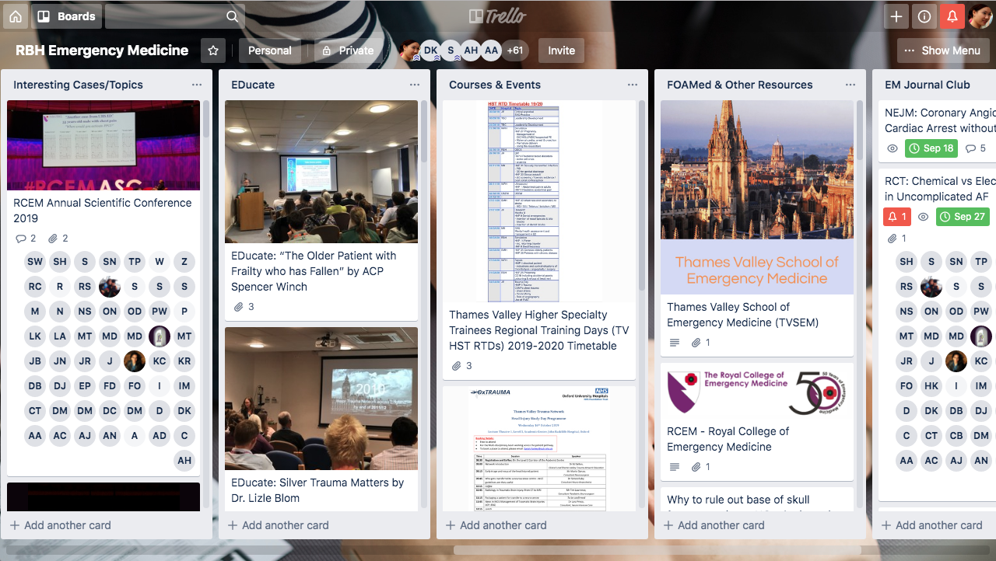
Desktop view

Slide 4
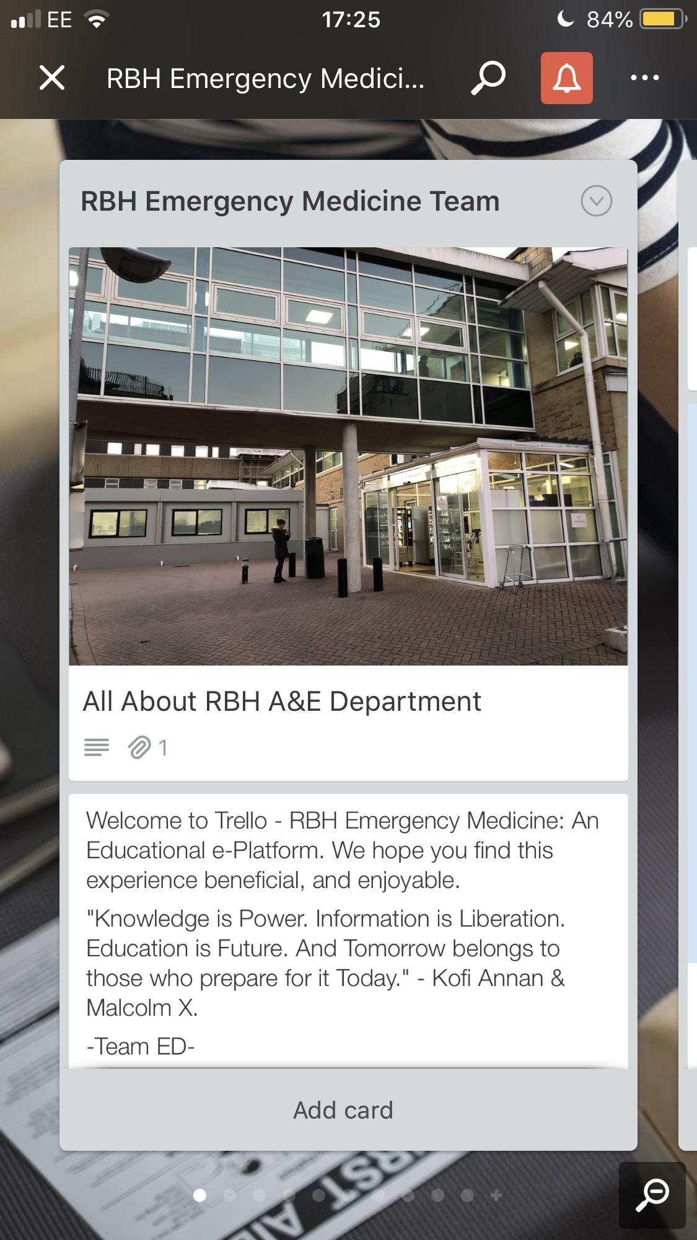
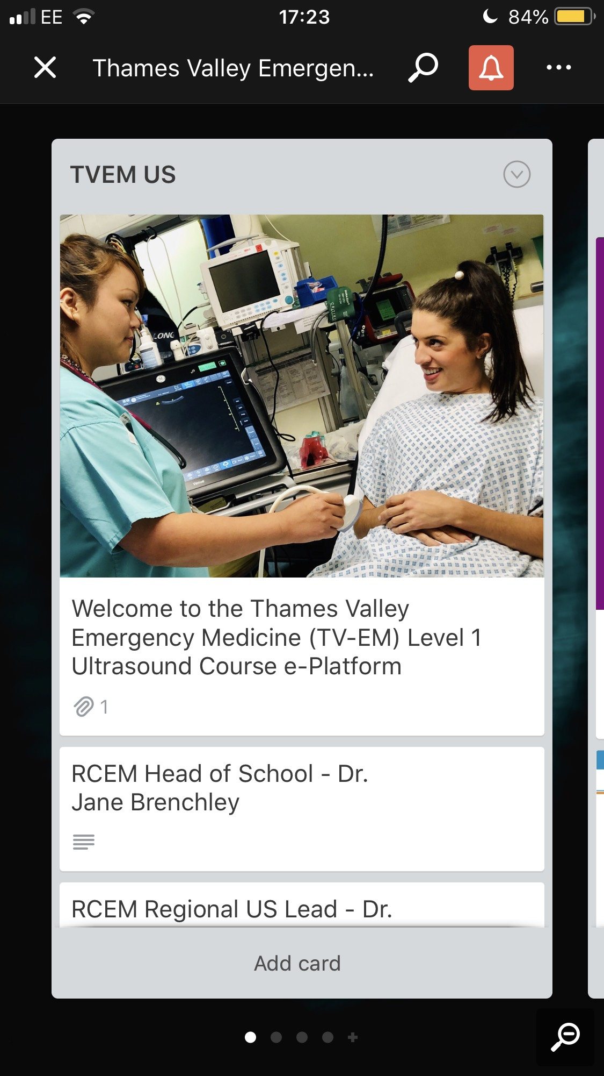
Mobile view

Slide 5
What was the purpose of Trello?
Accessible educational materials
Collaborative and shared learning experiences
Real-time information sharing
Improving practical and simulation learning experiences
‘Prospective & Retrospective’ discussions

Slide 6
How was Trello set-up? (Aug 18 – 19)
JL
Board Creator & Manager
DK
Stakeholder
HK
Champion (ST)
JK
Champion (SHO)
AC
Champion (PA)
ST
Stakeholder

Slide 7
How was Trello set-up? (Aug 19 onwards)
Board Creator & Manager
JL
Stakeholder (ED – Clinical Lead)
DK
Champion (ED – Registrars)
HK
Champion (ED – SHOs)
JK
Champion (PAs/ACPs)
AC
Stakeholder (ED – College Tutor)
ST
Stakeholder (ICM)
IR
Stakeholder (Anaesthetics)
JR
Stakeholder (COE)
NJ/KE
Champion (ICM)
WO
Champion (Anaesthetics)
FH

Slide 8
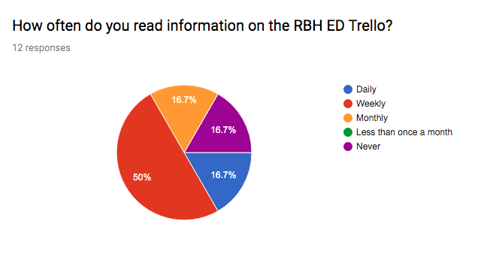
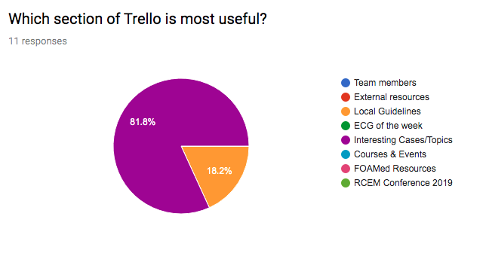
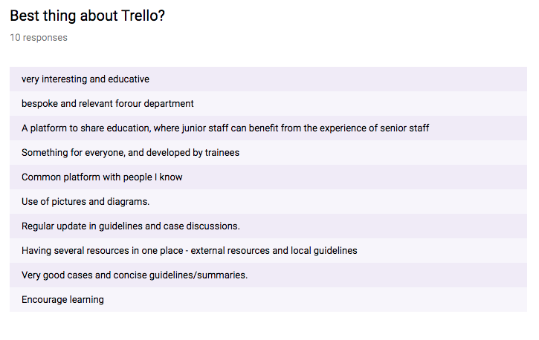
How has this improve Education & Training?

Slide 9
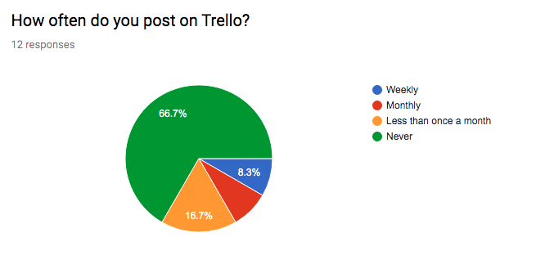
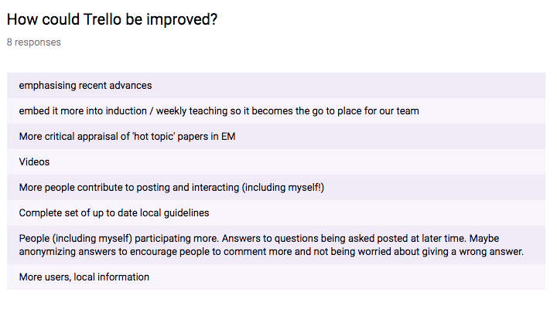
What are the issues?

Slide 10
What are the future plans?
Trello-related Activity | Events | Details
Practical skills | 1st Thames Valley EM Level 1 ‘Introductory’ US Course | 15th October 2019 - RBH
Simulation | Paediatric Procedural Sedation | 15th November 2019 - RBH
Retrospective discussions | ED Journal Club | Last Friday of every month
Wellness & Wellbeing | ED Social Events | Last Friday of every month
Video uploads
Induction
Forums
Trust App
MDT approach
Regional extension

Slide 11
Dr. Justine S. Loh RCP Chief Registrar in Emergency Medicine, Specialty Trainee in Emergency Medicine & Paediatric Emergency Medicine Royal Berkshire NHS Foundation Trust
Email: justine.loh@nhs.net
Twitter: @justineloh @RBHChiefRegs

