Slide 1




Emerging themes from HSIB investigations in Emergency Departments
Saskia Fursland
National Investigator
saskia.fursland@hsib.org.uk
www.hsib.org.uk
@hsib_org

Slide 2




My background

Slide 3
Overview
Brief introduction to the Healthcare Safety Investigation Branch (HSIB)
Emerging themes from HSIB investigations conducted in ED
Questions

Slide 4


Slide 6
National Investigations
Encompasses any patient safety concern that occurred within NHS-funded care in England after 1 April 2017
Decide what to investigate based on:
      Outcome Impact
      Systemic Risk
      Learning potential
Make safety recommendations at a national level

Slide 7
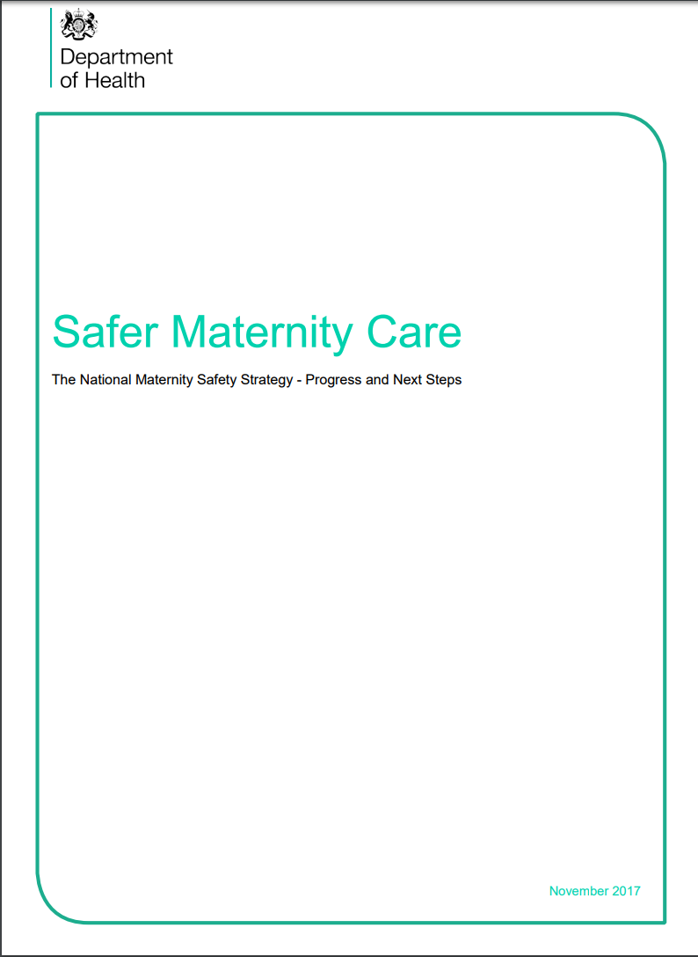

Maternity Investigations
National Maternity Safety Strategy Nov 2017
HSIB to undertake investigation of cases meeting EBC criteria (~1,000) & maternal deaths
Replace local Trust Serious Incident Investigation
Regional model
Investigators seconded from Trusts
Full national roll out completed in April 2019
Notes:
In November 2017, the Secretary of State for Health published a refreshed National Maternity Safety Strategy Safer Maternity Care announcing plans for HSIB to undertake around 1000 independent safety investigations into all cases in England meeting the Royal College of Obstetricians and Gynaecologists (RCOG) Each Baby Counts national quality improvement programme criteria as well as all maternal deaths linked to pregnancy.
The EBC programme gathers intelligence and information from local serious incident investigations in the NHS to build a picture of issues associated with maternity care across the UK. HSIB will investigate all cases in England that meet the EBC criteria of term babies (at least 37+0 weeks of gestation) born following labour who have one of the following outcomes:
Intrapartum stillbirth: where the baby was thought to be alive at the start of labour but was born with no signs of life;
Early neonatal death: when the baby died within the first week of life (0-6) days of any cause;
Severe brain injury diagnosed in the first 7 days of life, when the baby:
- Was diagnosed with grade III hypoxic ischaemic encephalopathy (HIE); or
- Was therapeutically cooled (active cooling only); or
- Had decreased central tone and was comatose and
In addition to the RCOG EBC cases, we will also investigate all maternal deaths linked to pregnancy.

Slide 8
Systems approach to investigation
“Systems thinking focuses more on the system rather than on human actions in order to learn how to redesign the system to reduce losses—where the system includes engineering design, construction, operations, management, and organizational structure.”
Leveson, Stringfellow and Thomas

Slide 9
Why use a systems approach in investigation?
Healthcare systems are complex and so you need to use an approach which embraces its complexity of interactions and interrelationships
The vast majority of healthcare incidents have systemic factors that may have influenced the sequence of events
Enables the investigation to look beyond ‘human error’
By understanding the factors which contribute to human error it is possible for recommendations to be defined and targeted at the right place to reduce the risk of reoccurrence

Slide 10


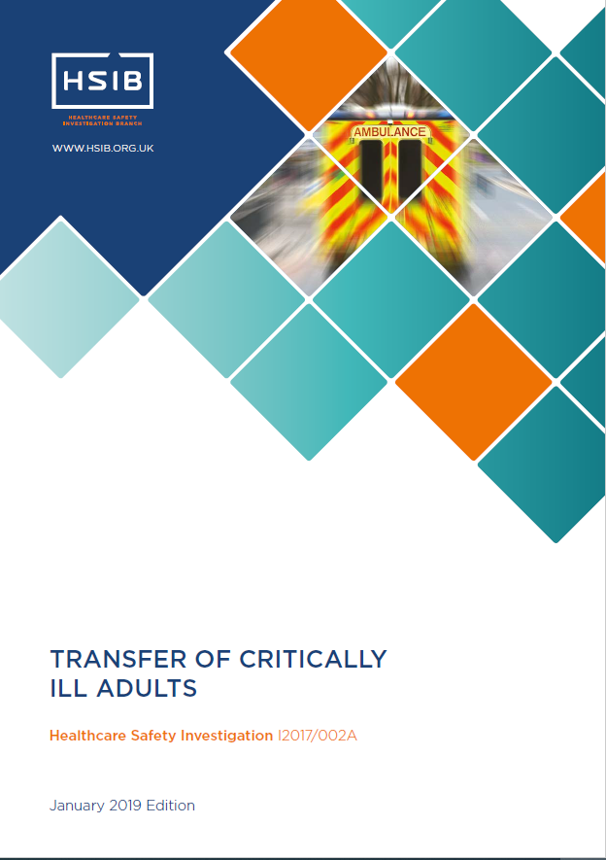

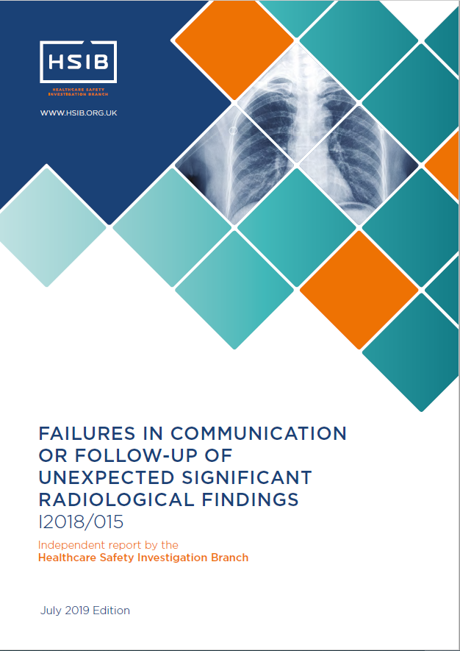
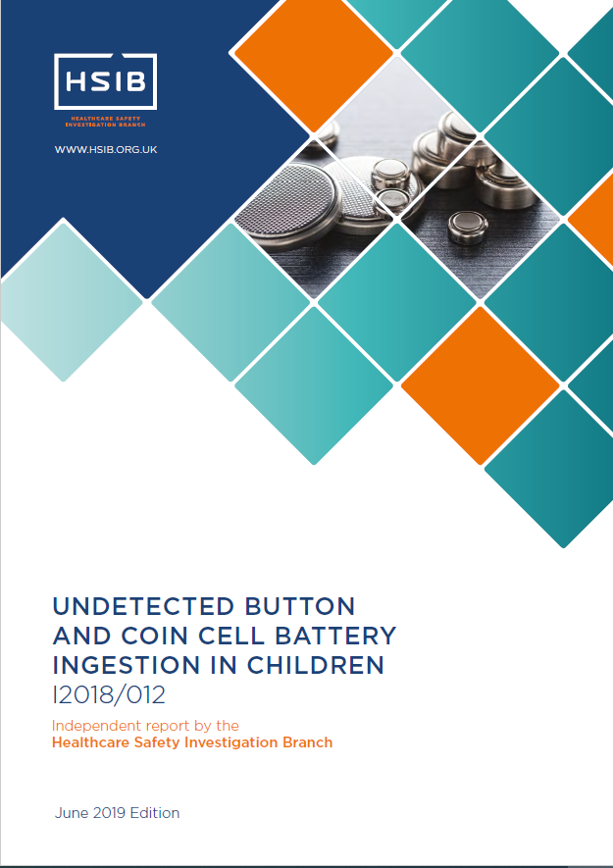
HSIB investigations which involve ED

Slide 11



Emerging themes from HSIB investigations in ED
Handover and transfer of clinical information
Guidance and standardisation
Misperception

Slide 12
Handover and transfer of clinical information
Distributed Situation Awareness
Distributed situation awareness considers how the system can be viewed, as a whole, by taking into account the information held by the actors, for example, medical records, people, and the way in which they interact.
Salmon, P.M., Stanton, N.A., Walker, G.H. Jenkins, D.P., and Rafferty, L. (2009). Is it really better to share? Distributed situation
awareness and its implications for collaborative system design. Theoretical Issues in Ergonomics Science. 11, 58-83.

Slide 13
Guidance and standardisation
Volume of guidance from multiple sources

Slide 14
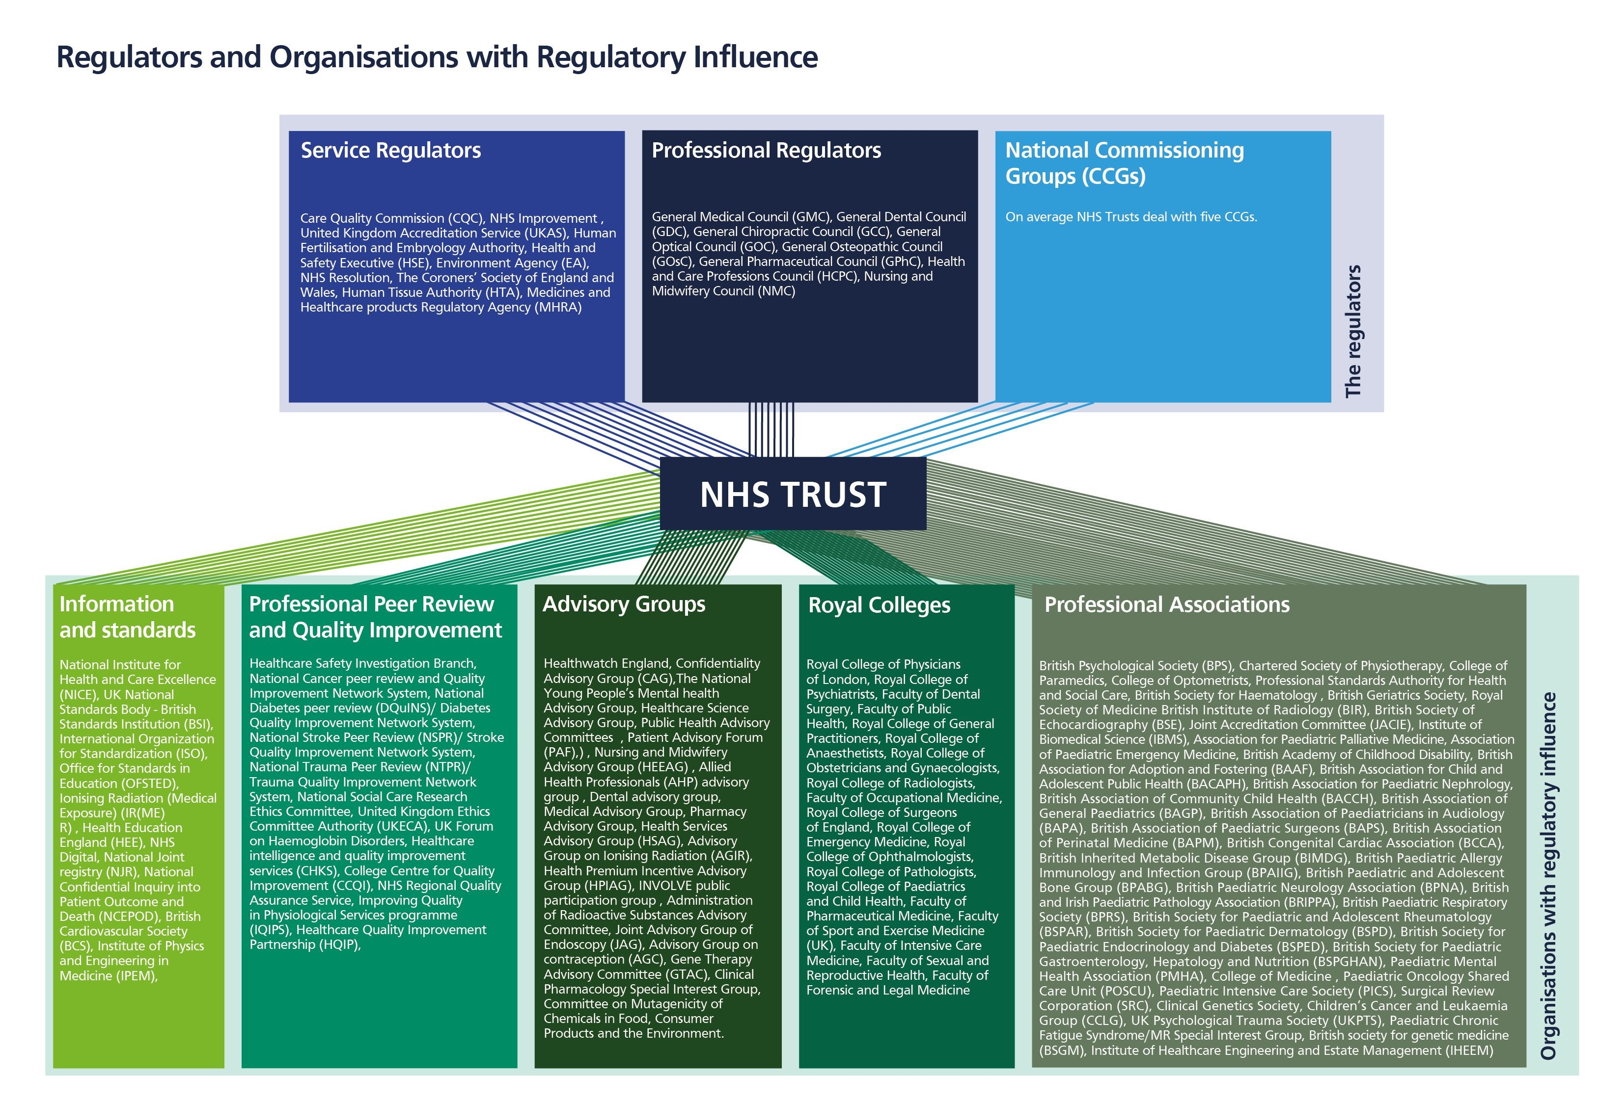
Over 126 organisations who exert some regulatory influence on NHS provider organisations
Oikonomou E, Carthey J, Macrae C, et al. Patient safety regulation in the NHS: mapping the regulatory landscape of healthcare. BMJ Open 2019;9:e028663. doi:10.1136/ bmjopen-2018-028663
Notes:
Oikonomou E, Carthey J, Macrae C, et al. Patient safety regulation in the NHS: mapping the regulatory landscape of healthcare. BMJ Open 2019;9:e028663. doi:10.1136/ bmjopen-2018-028663

Slide 15
Guidance and standardisation
Volume of guidance from multiple sources
Lack of standardisation
Outdated guidance still in circulation

Slide 16
Misperception
‘Wellness bias’
The patient who does not appear critically unwell

Slide 17
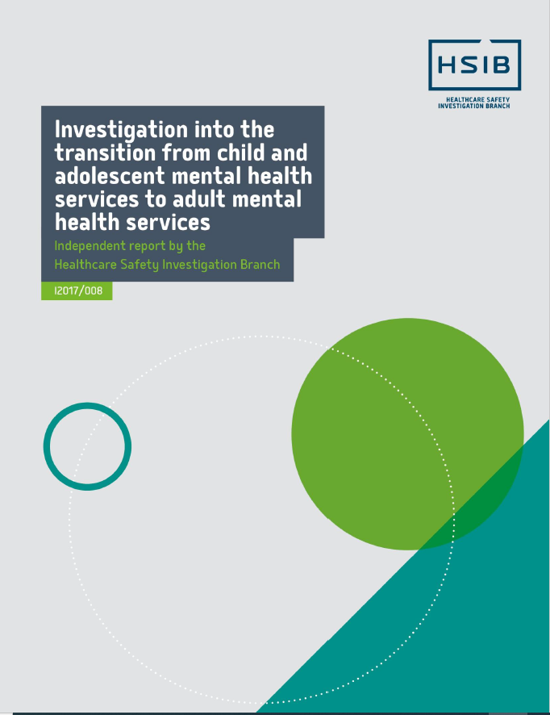
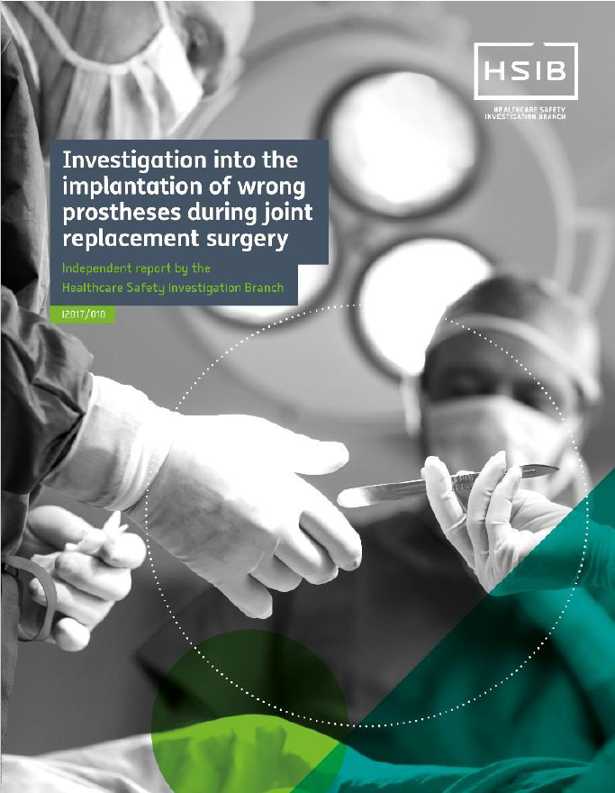
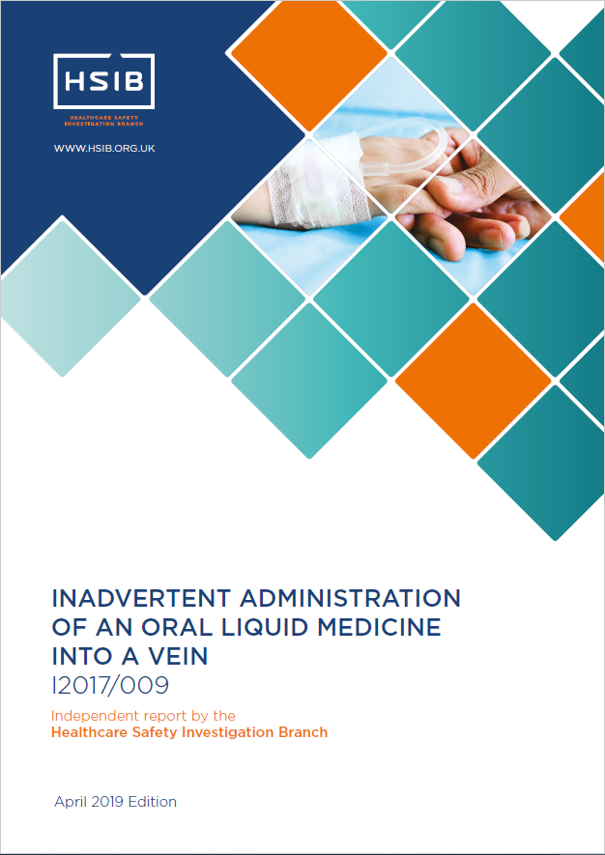
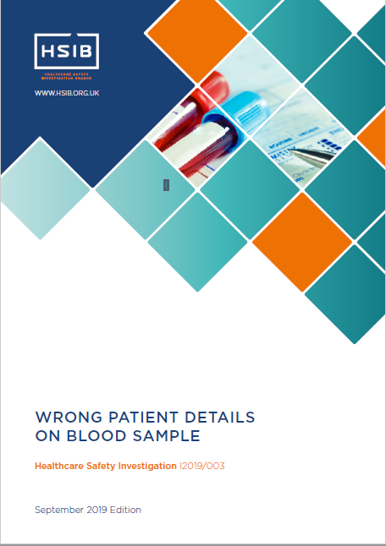
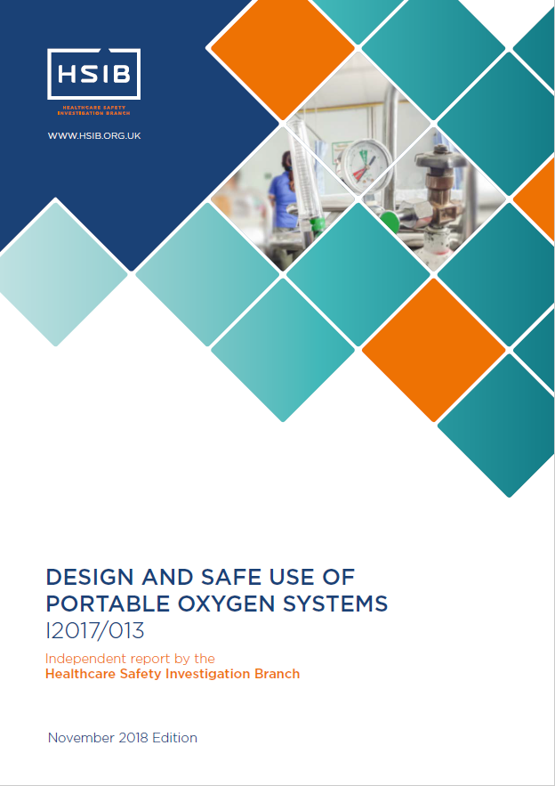

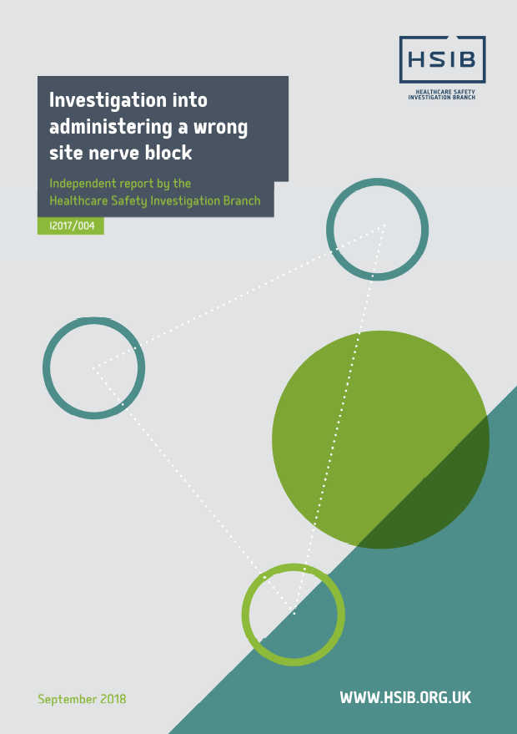
Reports can be downloaded from:
https://www.hsib.org.uk/investigations-cases/

Slide 18
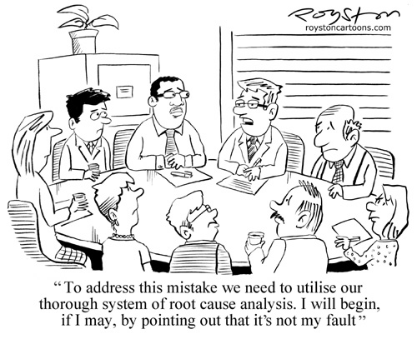
Saskia Fursland
National Investigator
saskia.fursland@hsib.org.uk
www.hsib.org.uk
@hsib_org

