Slide 1
Virtual Fracture Clinic
Oxford
Milton Keynes University Hospital

Slide 2
Name: Dr Divyansh Gulati Title: Consultant in Emergency Medicine Organisation: Milton Keynes University Hospital Contact details: divyansh.gulati@mkuh.nhs.uk

Slide 3
Historically, patient presents to the Emergency Department following an injury
After imaging and treatment in the ED, referred to fracture clinic for further review
Patient attends the fracture clinic at MKUH and then a plan of treatment is made if required

Slide 4
Limitations
Poor patient experience - Long wait to be seen
Lack of patient satisfaction - 30%~ of patients as no treatment was required after the long wait.
Cost implication - High attendees, therefore need for an extra registrar/physical space

Slide 5
Current Practice…

Slide 6
Patient seen in Emergency Department
Diagnostics and Treatment in ED
Referred to Virtual Fracture clinic for follow up
Imaging and Notes reviewed by T & O Consultant
Patient telephonically informed whether to attend fracture clinic for review/or discharge

Slide 7
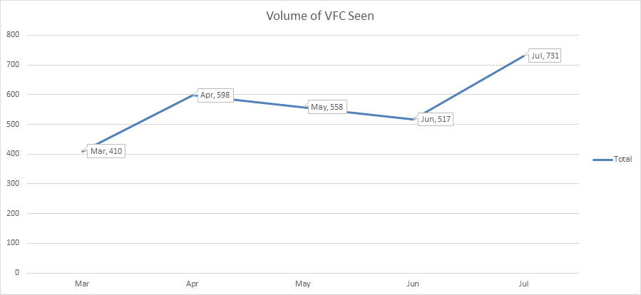

Slide 8
Quick wins
31.5% rate of discharge from the Virtual Fracture Clinic – these are all patients that would have historically attended physically
Patient experience has improved as the waiting time in the physical clinic has decreased
Staff morale is higher due to change in type of work and also satisfaction from happier patient group
Reduction in requirement to provide 3rd Middle Grade doctor to clinic

Slide 9
Lessons learnt
Inappropriate referrals- Local guidance and patient safety leaflets available
Wound review

